Slide 1
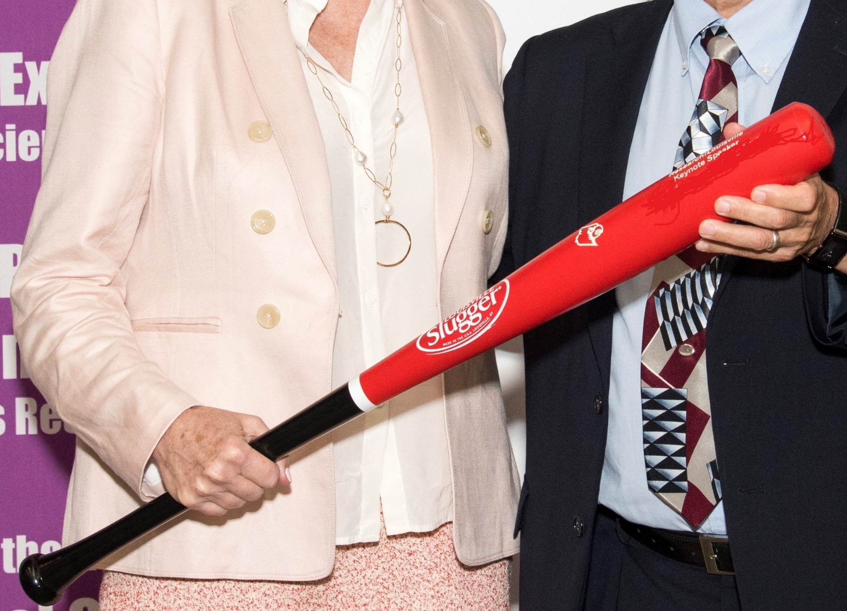

Slide 2




University of Louisville
Office of the Executive Vice President
for Research & Innovation
UofL Health Science Center Office
of Diversity & Inclusion Louisville
University of Louisville
School of Interdisciplinary & Graduate Studies

Slide 3

Pascale |  | Alard |  | Gil |  | Diamond |  | Paul |  | Himes |  | Michael |  | Merchant |  | Jerry |  | Rabalais |  | Jacqueline |  |  | Singleton
Timothy |  | Audam |  | stanley |  | DSouza |  | Kyung |  | Hong |  | Samineh |  | Mesbah |  | Anand |  | Ramalingam |  | Ahmed |  |  | Soliman
Mayukh |  | Banerjee |  | Ahmed |  | Elnakib |  | Joshua |  | Hood |  | Cynthia |  | Metz |  | Madhavi |  | Rane |  | Zhao-Hui |  |  | Song
Lalit |  | Batra |  | Sheref |  | Elseidy |  | Fahmi |  | Khalifa |  | Mike |  | Metz |  | Keming |  | Ren |  | Montray |  |  | Smith
Levi |  | Beverly |  | Kiana |  | Fields |  | LaCreis |  | Kidd |  | Karen (Sam) |  | Miller |  | Andrea |  | Reyes Vega |  | Jingjing |  |  | Zhao
Rumeysa |  | Biyik-Sit |  | Jane |  | Frimodig |  | Suzanne |  | King |  | Roshan |  | Mishr |  | Lynn |  | Roser |  | Yi |  |  | Tan
Collin |  | Bowersock |  | Nichola |  | Garbett |  | Irina |  | Kirpich |  | Tamer |  | Mohamed |  | Guillermo |  | Rougier |  | Kira |  |  | Taylor
Lu |  | Cai |  | Gina |  | Genova |  | Carolyn |  | Klinge |  | Robert |  | Monsen |  | Thomas |  | Roussel |  | Sucheta |  |  | Telang
Ana |  | Cardoso |  | Smita |  | Ghare |  | Murali |  | Kolikonda |  | Fata |  | Moradali |  | Dave |  | Samuelson |  | Beatrice |  |  | Ugiliweneza
Alex |  | Carll |  | Shirin |  | Ghods |  | Calvin |  | Kouokam |  | Lavina |  | Myers |  | Lisa |  | Sandell |  | Silvia |  |  | Uriarte
Carolyn |  | Casella |  | Leila |  | Gobejishvili |  | Karen |  | Krigger |  | MJ |  | Negahdar |  | Staci |  | Saner |  | Banrida |  |  | Wahlang
Brian |  | Ceresa |  | Evelyne |  | Gozal |  | Matthew |  | Lawrenz |  | Jennifer |  | Noel |  | William |  | Scarfe |  | Dennis |  |  | Warner
Venkata |  | Chandana |  | Frank |  | Groves |  | Chi |  | Li |  | Matt |  | Nystoriak |  | Gabriela |  | Schneider |  | Walter |  |  | Watson
Joseph |  | Chen |  | Sudha |  | Gudhimella |  | Qian |  | Lin |  | Ashley |  | O’Neil |  | David |  | Scott |  | Scott |  |  | Whittemore
Haixun |  | Guo | Guo-Liang (Ike) | Guo-Liang (Ike) |  | Cheng |  | Cynthia |  | Logsdon |  | Tim |  | O'Toole |  | Utpal |  | Sen |  | Sandra |  |  | Wise
Barbara |  | Clark |  | Petra |  | Haberzettl |  | Robert |  | Martin |  | Marty |  | O'Toole |  | Ahmed MA |  | Shaffie |  | Cheryl |  |  | Witt
Geoff |  | Clark |  | Lynne |  | Hall |  | Hector |  | Martinez |  | Alexander |  | Ovechkin |  | Ahmed |  | Shalaby |  | Sudeep |  |  | Yadav
Helen |  | Collins |  | Nazarul |  | Hasan |  | Nobiyuki |  | Matoba |  | Diana |  | Pantalos |  | Daniya |  | Sheikh |  | Ray |  |  | Yeager
James |  | Collins |  | Barbara |  | Head |  | Jessica |  | McDonnell |  | Jessica |  | Petrey |  | Jacob |  | Shreffler |  | Nagma |  |  | Zafar
Erin |  | Davis |  | David |  | Hein |  | Tara |  | McKinley |  | Michele |  | Pisano |  | Ryan |  | Simpson |  | Charlie |  |  | Zhang
Don |  | Demuth |  | April |  | Herrity |  | Paul |  | McKinney |  | Sathnur |  | Pushpakumar |  | Jill |  | Steinbach-Rankins |  |  | JC |  | States

Slide 4
Erika Figgins
2nd Place
Master’s Basic Science
Graduate Student Award
Mentor: Gill Diamond, PhD
Notes:
Tie for 2nd place

Slide 5
Raphael Ngozichi Suarez Jigo
1st Place
Master’s Basic Science
Graduate Student Award
Mentor: Geoffrey Clark, PhD

Slide 6
Idoia Meaza Isusi
3rd Place
Doctoral Basic Science
Graduate Student Award
Mentor: John P. Wise, Sr., PhD

Slide 7
Aaron Whitt
2nd Place
Doctoral Basic Science
Graduate Student Award
Mentor: Chi Li, PhD

Slide 8
Justin Kos
1st Place
Doctoral Basic Science
Graduate Student Award
Mentor: Corey Watson, PhD

Slide 9
Shah Tarun
3rd Place
Master Engineering Student Award
Mentor: Joseph Chen, PhD

Slide 10
Mohamed Elsharkawy
2nd Place
Master Engineering Student Award
Mentor: Ayman El-Baz, PhD

Slide 11
Anthony Kyser
1st Place
Master Engineering Student Award
Mentor: Jill Steinbach-Rankins, PhD

Slide 12
Mohamed Ali
3rd Place
Doctoral Engineering Student Award
Mentor: Ayman El-Baz, PhD

Slide 13
Mohamed Shehata
2nd Place
Doctoral Engineering Student Award
Mentor: Ayman El-Baz, PhD

Slide 14
Heba Kandil
1st Place
Doctoral Engineering Student Award
Mentor: Ayman El-Baz, PhD

Slide 15
Heejue Hong
3rd Place
School of Dentistry
Basic Science Award
Mentor: David Scott, PhD
School of Dentistry

Slide 16
Alec McDonald
2nd Place
School of Dentistry
Basic Science Award
Mentor: Sudha Gudhimella, BDS, MS
School of Dentistry

Slide 17
Isaac Feinn
1st Place
School of Dentistry
Basic Science Award
Mentor: Lisa Sandell, PhD
School of Dentistry

Slide 18
Arthur Begotti Silva
3rd Place
School of Dentistry
Clinical Science Award
Mentor: Liliana Rozo, DDS
School of Dentistry

Slide 19
Meghan Nay
2nd Place
School of Dentistry
Clinical Science Award
Mentor: Michael Metz, DMD, PhD
School of Dentistry

Slide 20
Madison Chumbler
1st Place
School of Dentistry
Clinical Science Award
Mentors: Nicole Herring, PhD
Jennifer Brueckner-Collins, PhD
School of Dentistry

Slide 21
Manasaa Kannan
3rd Place
Rhonda A. Hoffman
Medical Student Award
Mentor: Nicola Garbett, PhD
Notes:
3 way tie for 2nd place

Slide 22
Jingjing Cao
2nd Place
Rhonda A. Hoffman
Medical Student Award
Mentor: Hasan Nazrul, PhD
Notes:
3 way tie for 2nd place

Slide 23
Madelaine Stanback
1st Place
Rhonda A. Hoffman
Medical Student Award
Mentor: Hellen Collins, PhD

Slide 24
Josiah Hardesty, PhD
1st Place
Postdoctoral Fellow Award
Mentor: Irina Kirpich, PhD
Executive Vice President for Research and Innovation

Slide 25
Alexandra Nail, PhD
1st Place
Postdoctoral Fellow Award
Mentor: J. Christopher States, PhD
Executive Vice President for Research and Innovation

Slide 26
Jamie Young, PhD
1st Place
Postdoctoral Fellow Award
Mentor: Lu Cai, PhD
Executive Vice President for Research and Innovation

Slide 27
Jianzhu Luo
2nd Place
Research Associate/Research Scientist Award
Mentor: Banrida Wahlang, PhD
Executive Vice President for Research and Innovation

Slide 28
Parag Shah, Ph.D.
1st Place
Research Associate/Research Scientist Award
Mentor: Levi Beverly, PhD
Executive Vice President for Research and Innovation

Slide 29
Megan Bezold
Winner
Research Staff Award
Mentor: Krystal Teasley Hamorsky, PhD
Notes:
29

Slide 30
Pooyan Sadr Eshkevari,DDS
Winner
School of Medicine
Medical Resident Award
School of Medicine

Slide 31
Simone Chang, MD
Winner
School of Medicine
Clinical Research Fellow Award
Mentor: Sucheta Telang, MBBS
School of Medicine

Slide 32
Emily Reece
2nd Place
Public Health & Information Sciences
Graduate Student Award
Mentor: Kira Taylor, PhD, MS
School of Public Health and Information Sciences

Slide 33
Stephie Abraham
2nd Place
Public Health & Information Sciences
Graduate Student Award
Mentor: Stephanie Boone, PhD
School of Public Health and Information Sciences

Slide 34
Yuanbao Zhang
1st Place
Public Health & Information Sciences
Graduate Student Award
Mentor: Qunwei Zhang, MD, MPH, PhD
School of Public Health and Information Sciences

Slide 35
Yiqun Mo, MD,PhD
Winner
Public Health & Information Sciences
Post-Doctoral Scholars and Research Associates Award
School of Public Health and Information Sciences

Slide 36
Kofi Amoh Mensah
Winner
School of Nursing
Graduate Student Award
Mentor: Sha Shuying, PhD
School of Nursing

Slide 37
Banrida Wahlang, PhD
Winner
Faculty Award in Basic Science

Slide 38
Goutam Singh, PhD
Winner
Faculty Award in Clinical Science

Slide 39
Kendall Yount
3rd Place
Ruth Greenberg Award for Medical Education Research
Mentor: Laura Weingartner, PhD
Office of Medical Education
School of Medicine
Notes:
39

Slide 40
Carrie Bohnert
2nd Place
Ruth Greenberg Award for Medical Education Research
Mentor: Laura Weingartner, PhD
Office of Medical Education
School of Medicine
Notes:
40

Slide 41
Michael Metz, DMD, PhD
1st Place
Ruth Greenberg Award for Medical Education Research
Office of Medical Education
School of Medicine
Notes:
41

Slide 42
Tanya Nagpal
Winner
Leslie Martin Medical Education Student Award
Mentor: Laura Weingartner, PhD
Office of Medical Education
School of Medicine
Notes:
42

Slide 43
Hallie Decker
3rd Place
Excellence in Health Disparities Research Award
Health Science Center
Office of Diversity & Inclusion Louisville
Notes:
43

Slide 44
Carrie Bohnert, MPA
2nd Place
Excellence in Health Disparities Research Award
Health Science Center
Office of Diversity & Inclusion Louisville
Notes:
44

Slide 45
Collin White
1st Place
Excellence in Health Disparities Research Award
Health Science Center
Office of Diversity & Inclusion Louisville
Notes:
45

Slide 46
Julia Corman
3rd Place
NCI Cancer Education Program
Norbert J. Burzynski Award
Undergraduate Student Category
Mentor: Joshua Fuqua, PhD

Slide 47
Luke Schroeder
3rd Place
NCI Cancer Education Program
Norbert J. Burzynski Award
Undergraduate Student Category
Mentor: Joshua Hood, PhD

Slide 48
Joanna Feng
2nd Place
NCI Cancer Education Program
Norbert J. Burzynski Award
Undergraduate Student Category
Mentor: Leah Siskind, PhD

Slide 49
Dietrich Sears
1st Place
NCI Cancer Education Program
Norbert J. Burzynski Award
Undergraduate Student Category
Mentor: John Trent, PhD

Slide 50
Noela Botaka
3rd Place
NCI Cancer Education Program
Norbert J. Burzynski Award
Professional Student Category
Mentor: Paula Bates, PhD

Slide 51
Jenny Chen
2nd Place
NCI Cancer Education Program
Norbert J. Burzynski Award
Professional Student Category
Mentor: Wenke Feng, PhD

Slide 52
Lakynkalina McCaffrey
1st Place
NCI Cancer Education Program
Norbert J. Burzynski Award
Professional Student Category
Mentor: J. Christopher States, PhD

